Slide 1


GitHub Actions Intro & Demo

Slide 2
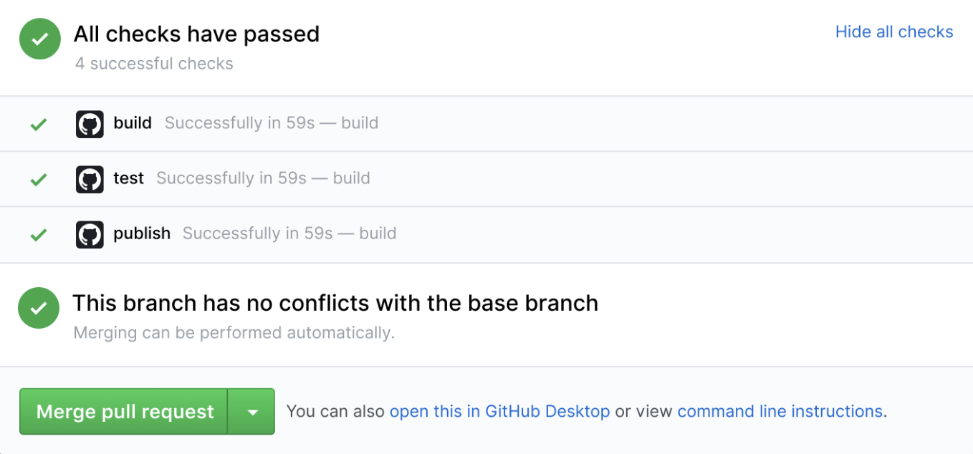
What is GitHub Actions?
Workflow engine built around GitHub events
Not just for CI/CD
Container-based
Any language, any platform
Built-in secret store
OIDC Identity provider
Community actions marketplace
10,000+ actions

Slide 3
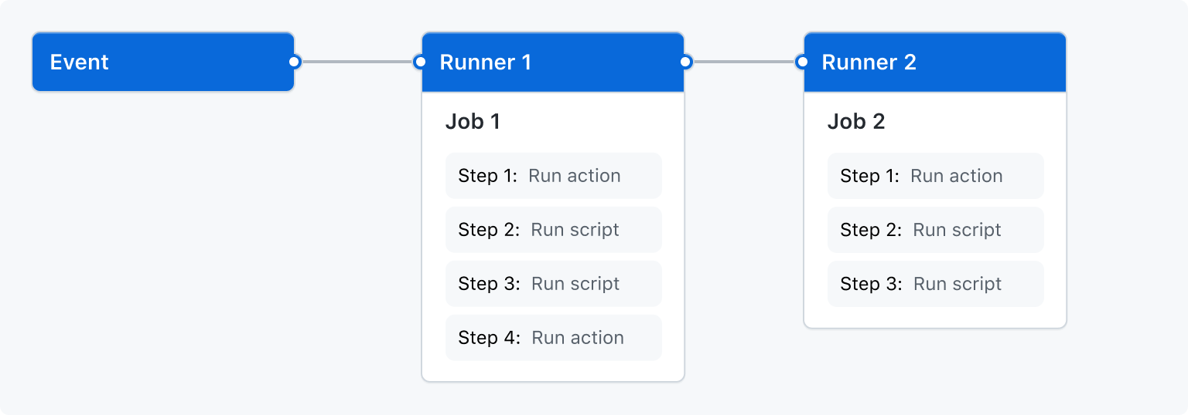
Workflow
YAML-based configurable process
One or more jobs per workflow
series or parallel execution
Workflows can be reusable
Triggered by an event
Runs a job
Job is a series of steps

Slide 4
Triggers
36 different types of events
Including external triggers
Event payload
Filterable
Input variables
Most common:
Push to branch
Pull request
Issue created
Schedule
on:
push:
branches:
- main
- 'releases/**’
- '!releases/**-alpha'
on:
push:
branches: [main]
pull_request:
types: [opened]
branches: [main]

Slide 5
Jobs
Series of steps
Series or parallel with other jobs
Inputs/outputs
Matrix (loop)
Conditions (ifs)
Separate environments
Runners
Shared or self-hosted
jobs:
build-website:
runs-on: ubuntu-latest
steps:
- uses: actions/checkout@v3
- uses: actions/setup-node@v3
with:
node-version: '14’
- run: npm run build

Slide 6
Steps
Always in series
Marketplace, custom, or container
Shells
bash, python, js, powershell
Conditionals (ifs)
Inputs/outputs
Environment variables
jobs:
build-website:
runs-on: ubuntu-latest
steps:
- uses: actions/checkout@v3
- uses: actions/setup-node@v3
with:
node-version: '14’
- run: npm run build
env:
- title: My Awesome Website

Slide 7
Availability
Faculty/Staff
GitHub-provided runners
Private, but on shared, public infrastructure
Monthly allowance
TAMU Private runners
Private, on private computer cluster
Campus connectivity
Self-hosted runners
Unique hardware or software needs
Run on your infrastructure

Slide 8

Lab 1
Sign-in to github.com
Go to skills.github.com
Choose Hello GitHub Actions
Fork the repo or click Start Course
Use your personal GitHub account

